Slide 1
Sample Efficient Prioritized Experience Replay for Adversarial Environments
Tianyang Duan, Zongyuan Zhang, Zekai Sun, Heming Cui

Slide 2
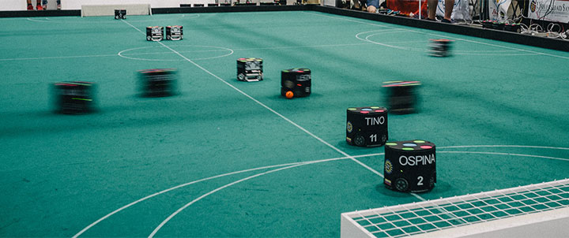
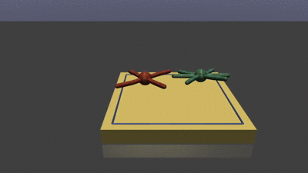
Motivation
Adversarial environment
Non-stationary environment
Zero-sum game
Fast-changing and unpredictable opponents
Reinforcement learning
Controls the action of agent based on rewards
Maximize the expected returns
Continuously interacting with the environment
In real robotics adversarial environment: expensive training and sparse samples
Sample efficiency needs to be improved in real robotics adversarial environments to accelerate real-time training.
Robot soccer
RoboSumo

Slide 3
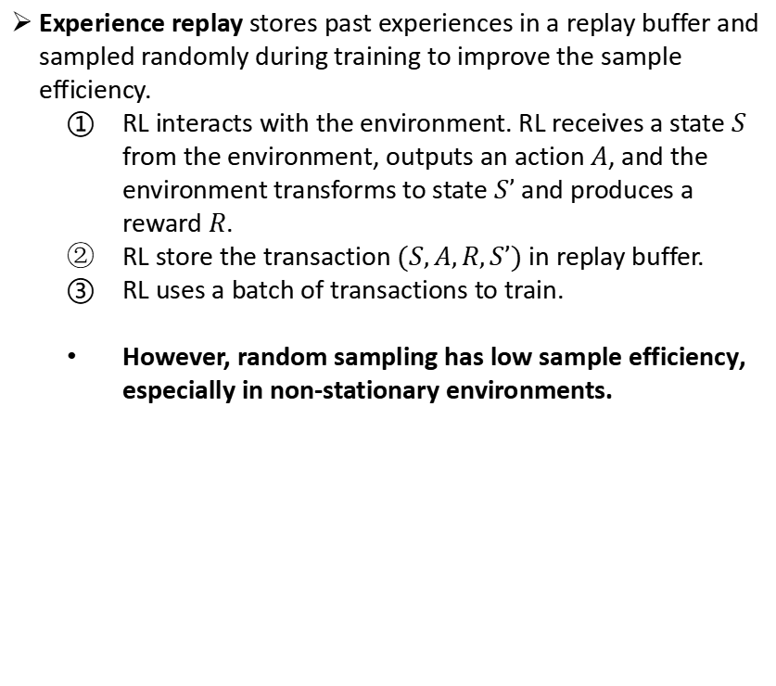
Experience Replay
Experience replay stores past experiences in a replay buffer and sampled randomly during training to improve the sample efficiency.
RL interacts with the environment. RL receives a state $S$ from the environment, outputs an action $A$, and the environment transforms to state $S’$ and produces a reward $R$.
RL store the transaction $(S,A,R,S’)$ in replay buffer.
RL uses a batch of transactions to train.
However, random sampling has low sample efficiency, especially in non-stationary environments.
RL
Env
①
agent
②
③
Replay Buffer

Slide 4

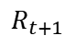
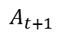
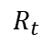
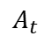
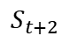
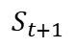
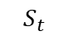
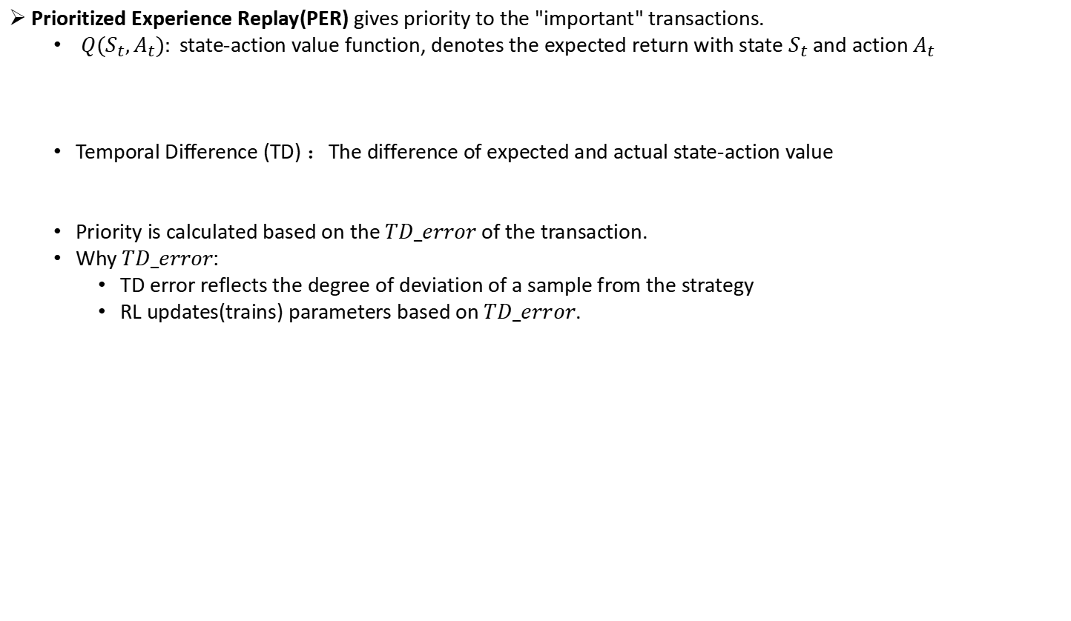
Existing Prioritized Experience Replay Method
A transaction
...
$$A_{t}$$
$$A_{t+1}$$
...
$$S_{t}$$
$$S_{t+1}$$
$$S_{t+2}$$
$$R_{t}$$
$$R_{t+1}$$
Prioritized Experience Replay(PER) gives priority to the "important" transactions.
$Q(S_{t},A_{t}):$state-action value function, denotes the expected return with state $S_{t}$ and action $A_{t}$
Temporal Difference (TD) ：The difference of expected and actual state-action value
Priority is calculated based on the $TD_error$ of the transaction.
Why $TD_error$:
TD error reflects the degree of deviation of a sample from the strategy
RL updates(trains) parameters based on $TD_error$.
$$Q(S_{t},A_{t})≈\sum_{k=t}^{T}{R_{k}=R_{t}+\sum_{k=t+1}^{T}{R_{k}≈R_{t}+Q(S_{t+1},A_{t+1})}}$$
$${TD_error=R}_{t}+Q(S_{t+1},A_{t+1})−Q(S_{t},A_{t})$$
$$Choose A_{t+1} from S_{t+1} using policy derived from Q$$
$$Q(S_{t},A_{t})←Q(S_{t},A_{t})+α[R_{t}+Q(S_{t+1},A_{t+1})−Q(S_{t},A_{t})]$$

Slide 5
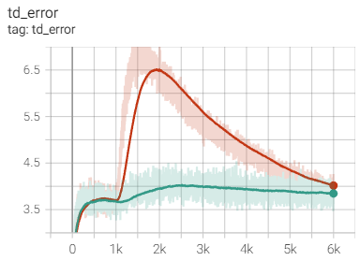
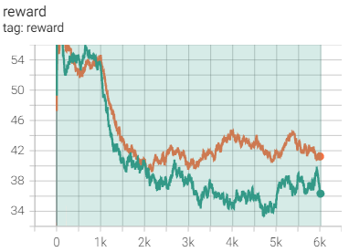
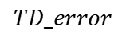
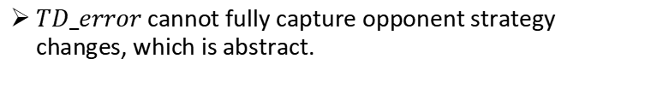
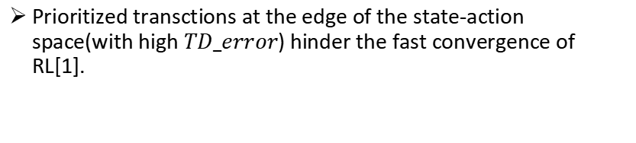
Problems of Existing PER Method in Adversarial Environment
Prioritized transctions at the edge of the state-action space(with high $TD_error$) hinder the fast convergence of RL[1].
Changes in environment
High TD error
State-action space edge
$$TD_error$$
Reward
$TD_error$ cannot fully capture opponent strategy changes, which is abstract.
Thus, the Prioritized Experience Replay Method cannot solve the sample efficiency in adversarial environments.
Environment changes at 1k step
Orange: motion friction
Green: opponent strategy change
[1] Cao, Xi, et al. "High-value prioritized experience replay for off-policy reinforcement learning." 2019 IEEE 31st International Conference on Tools with Artificial Intelligence (ICTAI). IEEE, 2019.

Slide 6
From Temporal Difference to Adversarial Difference
We propose Adversarial Difference (AD) which compares the expected returns between old and new opponents.
Why AD:
TD reflects the degree of deviation of a sample versus the same opponent
AD reflects the degree of deviation of a sample versus the different opponent
We propose Adversarial Prioritized Experience Replay (APRE) based on AD.
For improving sample efficiency in adversarial environments
APRE faces the following challenges:
How to define old and new transactions
How to trade-offs between old and new transaction

Slide 7
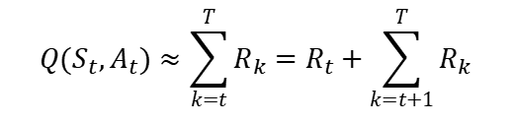
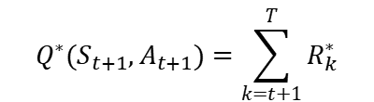
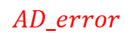
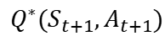
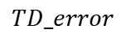
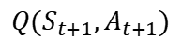
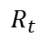
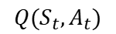
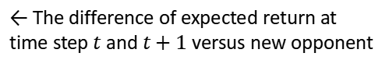
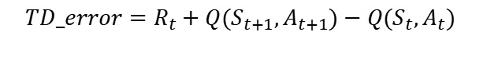
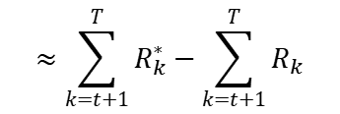
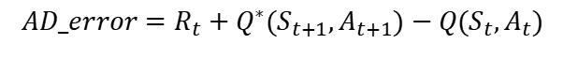
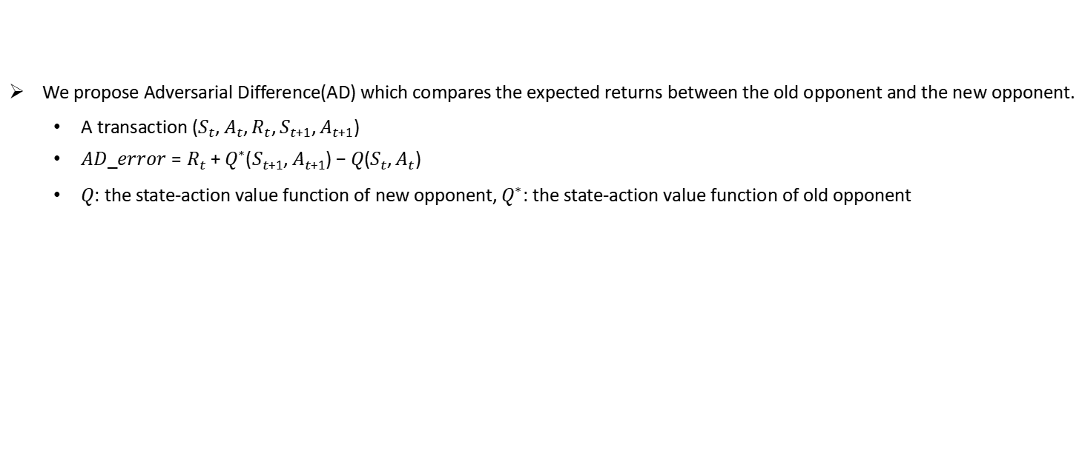
Key Idea: Adversarial Difference
We propose Adversarial Difference(AD) which compares the expected returns between the old opponent and the new opponent.
A transaction $(S_{t},A_{t},R_{t},S_{t+1},A_{t+1})$
$AD_error={R_{t}+Q}^{∗}(S_{t+1},A_{t+1})−Q(S_{t},A_{t})$
$Q$: the state-action value function of new opponent$, Q^{∗}$: the state-action value function of old opponent
$$Q(S_{t},A_{t})$$
$$Q(S_{t},A_{t})≈\sum_{k=t}^{T}{R_{k}=R_{t}+\sum_{k=t+1}^{T}{R_{k}}}$$
← Expected return versus new opponent
$$R_{t}$$
$$Q(S_{t+1},A_{t+1})$$
$$TD_error$$
← The difference of expected return at time step $t$ and $t+1$ versus new opponent
$${TD_error=R}_{t}+Q(S_{t+1},A_{t+1})−Q(S_{t},A_{t})$$
$$R_{t}$$
$$Q^{∗}(S_{t+1},A_{t+1})=\sum_{k=t+1}^{T}{R_{k}^{∗}}$$
← Expected return versus old opponent
$$Q^{∗}(S_{t+1},A_{t+1})$$
$$AD_error$$
$$AD_error={R_{t}+Q}^{∗}(S_{t+1},A_{t+1})−Q(S_{t},A_{t})$$
← The difference of expected return versus old opponent and new opponent
$$≈\sum_{k=t+1}^{T}{R_{k}^{∗}}−\sum_{k=t+1}^{T}{R_{k}}$$

Slide 8
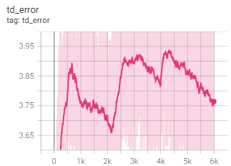
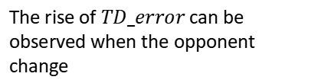
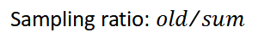
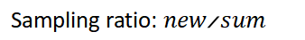
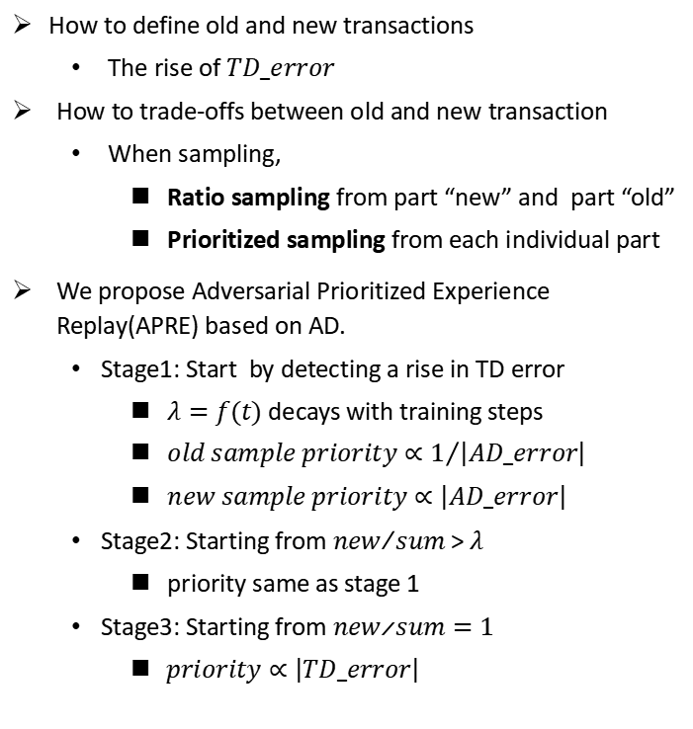
APER: Adversarial Prioritized Experience Replay
How to define old and new transactions
The rise of $TD_error$
How to trade-offs between old and new transaction
When sampling,
Ratio sampling from part “new” and part “old”
Prioritized sampling from each individual part
We propose Adversarial Prioritized Experience Replay(APRE) based on AD.
Stage1: Start by detecting a rise in TD error
$λ=f(t)$ decays with training steps
$old sample priority∝1/{\left|AD_error\right|}$
$new sample priority∝\left|AD_error\right|$
Stage2: Starting from ${new}/{sum }$>$λ$
priority same as stage 1
Stage3: Starting from ${new}/{sum}=1$
$priority∝\left|TD_error\right|$
The rise of $TD_error$ can be observed when the opponent change
Replay Buffer
Store a transaction
Stage 1
Old
Old
Old
Old
...
Old
New
New
New
Sampling ratio: 1-λ
Sampling ratio: λ
Stage 2
Old
Old
Old
...
Old
New
New
New
...
New
Sampling ratio: ${old}/{sum}$
Sampling ratio: ${new}/{sum}$
Stage 3
New
New
New
New
New
New
New
...
New
Sampling ratio: 1

Slide 9
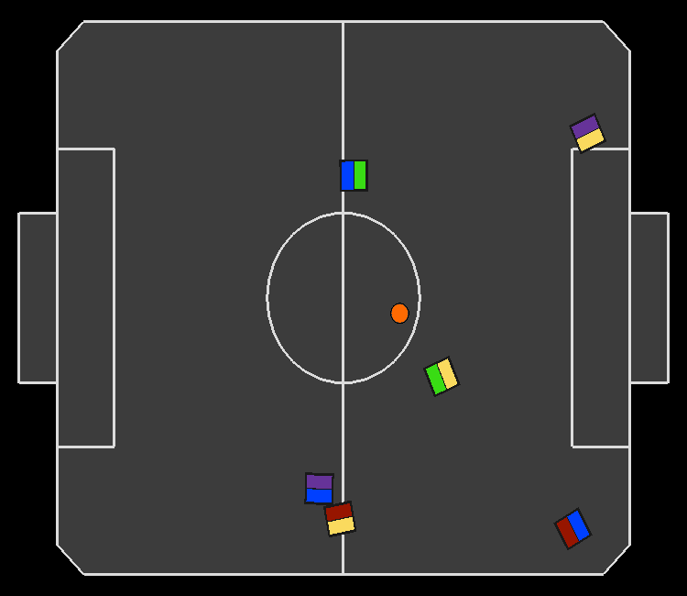
Implementation and Evaluation
Evaluation environment:
rSoccer - IEEE VSSS environment to simulate a robot soccer scenario.
RL algorithm:
TD3 (Twin Delayed DDPG): a state-od-the-art RL algorithm for continuous control tasks
Baseline:
Vanilla-ER
Prioritized Experience Replay (PER)
Combined Experience Replay (CER)
Evaluation settings:
3 vs 3 robot soccer match
Each agent controls one player
Follow the rewards shaping in rSoccer
Each match lasting 200 time steps

Slide 10
Evaluation Questions
Does the method improve sample efficiency in adversarial environments?
How does difference priority help to reduce the efficiency damage caused by outdated transactions?
How sensitive is the method to certain critical sampling-related hyperparameters , such as batch size and buffer size?

Slide 11
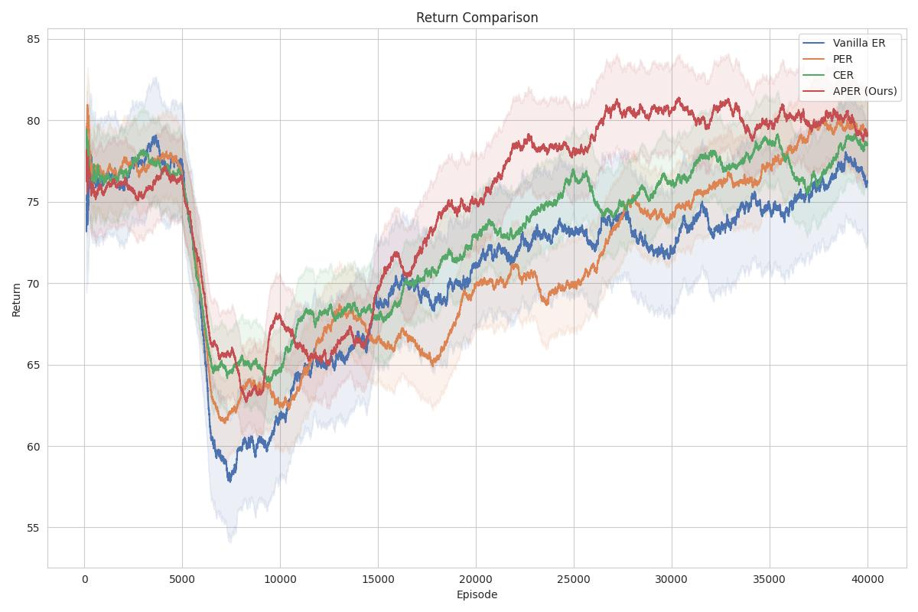
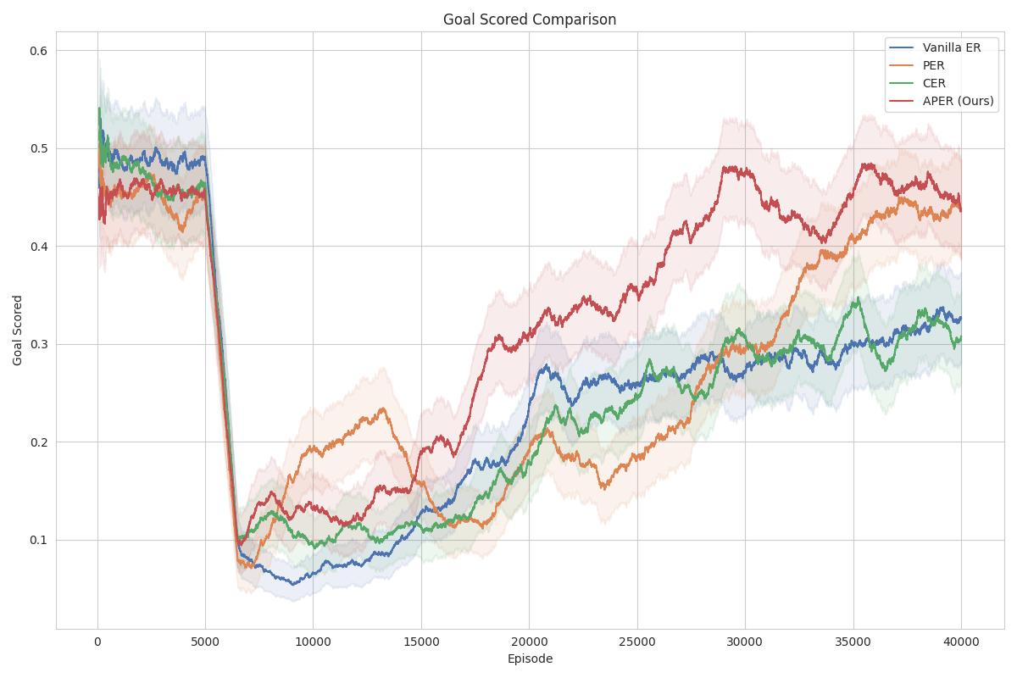
End-to-end Performance
APER (Red line) take a minimum of episodes to restore the average reward before changing the opponent policy, with a 46.64% improvement to Vanilla ER.
Training method：
Play in the above experimental environment
All methods start from the same pre-trained model
All methods use the same hyperparameters, with learning rate = 1× 10⁻⁴, batch size = 1024, buffer size = 5 × 10⁵.
At 5000 episodes, the opponent's strategy will be changed from offensive to defensive
Replay | Episodes spent to restore the original rewards | Improvement over vanilla ER
APER (Ours) | 14695 | 46.64%
CER | 19698 | 28.48%
PER | 22064 | 19.89%
Vanilla ER | 27543 | -

Slide 12
Conclusion
In this talk, we present APER, a sample efficient prioritized experience replay for adversarial environments.
APER detects the changes of the opponent by the rise of TD error.
APER uses ratio sampling to trade off between the new transactions and old transactions.
We propose adversarial difference (AD), which compares the expected gains between different opponents. APER samples from new and old transactions according to AD and 1/AD priority, respectively.
APER take a minimum of episodes to restore the average reward before changing the opponent policy, with a 46.64% improvement to Vanilla ER.

Slide 13
Future work
Short-term work
Evaluate APER in other adversarial environments (e.g. RoboSumo, Pong)
Evaluate APER with other RL algorithms (e.g. A2C,DDPG)
Long-term work
Apply APER in real robotic multi-agent reinforcement learning environments
Experience replay sharing in distributed training
Apply APER in Deep Reinforcement Learning

